Slide 1

Chicago Crime Rates
Anton Kamenov
Cristian Guba
Stefanos Agelastos

Slide 2
The Dataset
ID - Unique identifier for the record.
Date - Date when the incident occurred.
Block - The partially redacted address
IUCR - The Illinois Unifrom Crime Reporting code.
Description – of the crime
Primary Type – of the crime
Description -
Location Description
Arrest
Beat
District
Ward
Community Area
FBI Code
X Coordinate
Y Coordinate
Year - Year
Latitude
Longitude
Dataset includes crimes from 2012-2016
It has 1 456 714 entries
Question:
Does time and location influence the crime rate?

Slide 3
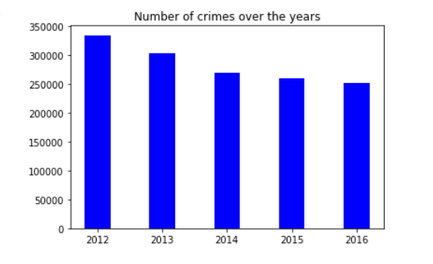
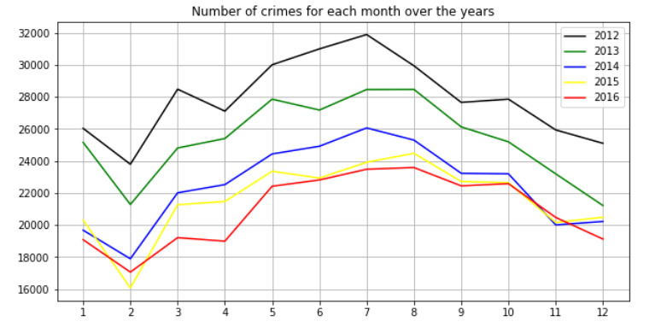
Exploring the data
The dataset has 1 456 714 entries
After removing the null values
there were – 1 419 630

Slide 4
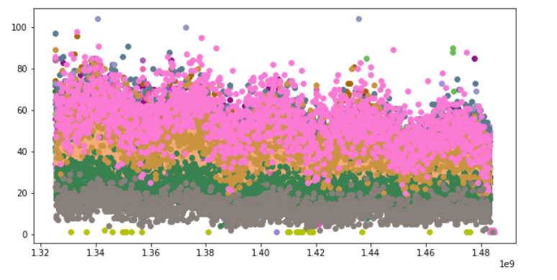
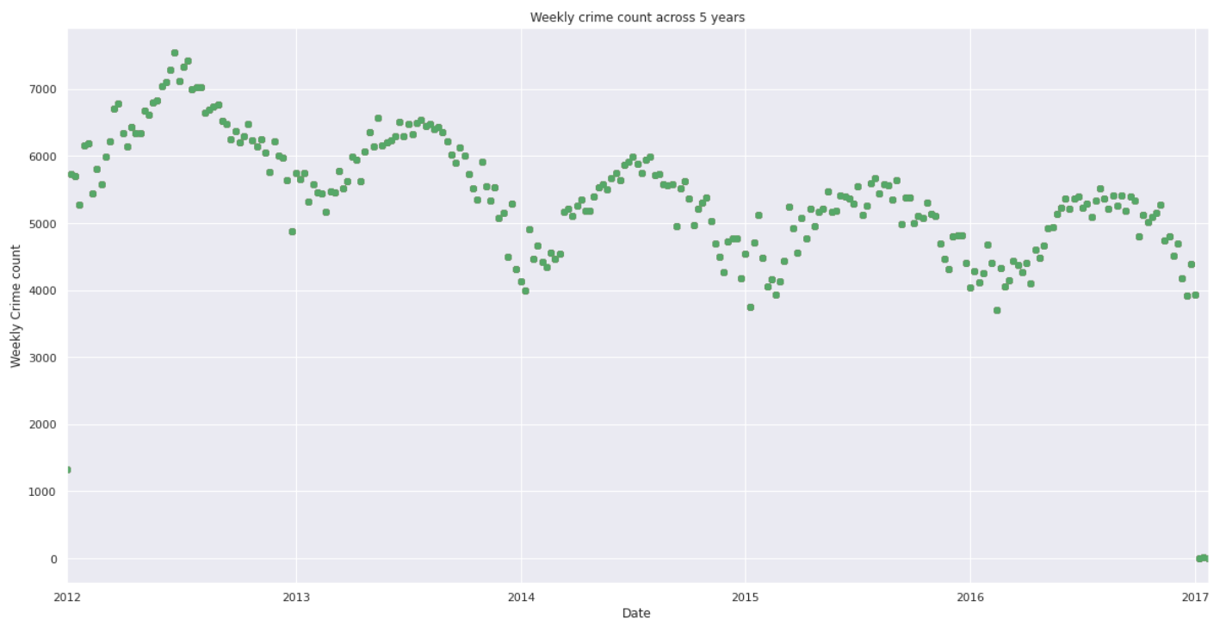
Exploring the data
Amount of crimes for each district base on the timestamp
Amount of crimes for each week during the years

Slide 5
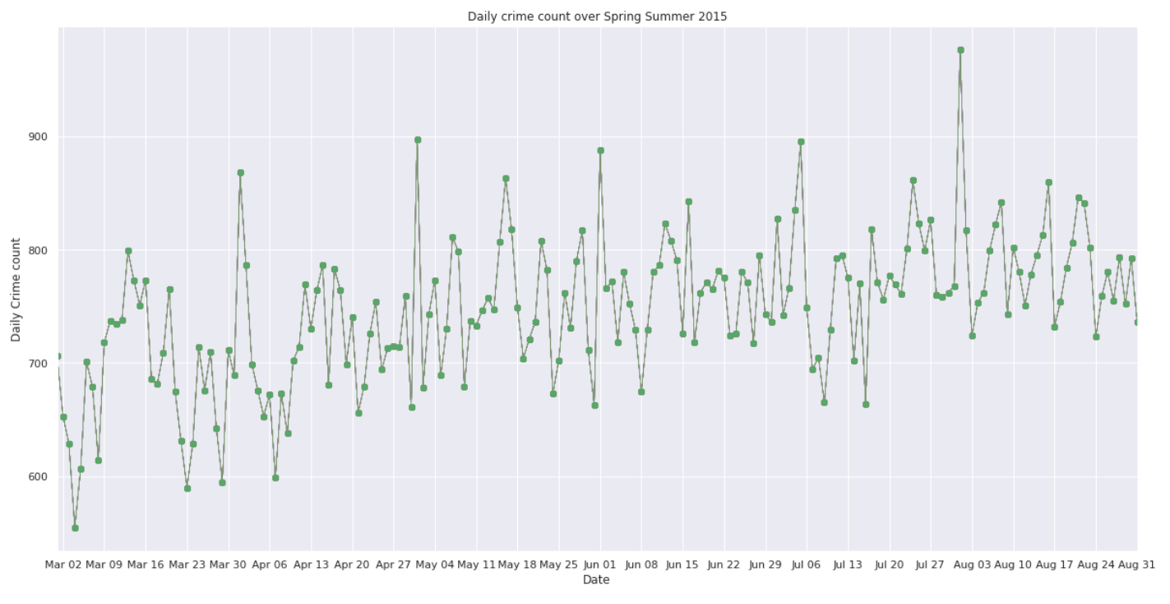
Data Exploration

Slide 6
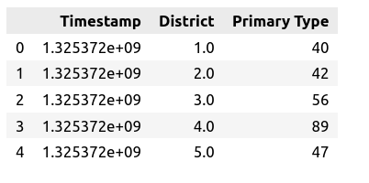
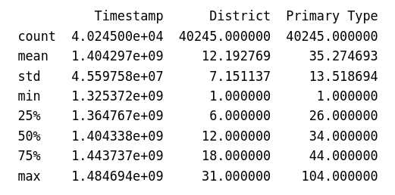
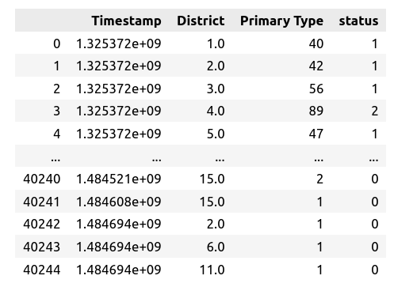
Feature Engineering
The ‚Primary Type‘ is converted to hold the sum of crimes for each timestamp
The mean of Primary Type is – 35.
Based on that a new feature is made to hold the status of crime rate.
  X <= 35 → 0 – Low Alert
  X > 35 and X <= 70 → 1 – Medium Alert
  X > 70 and X <= 104 → 2 – High Alert

Slide 7
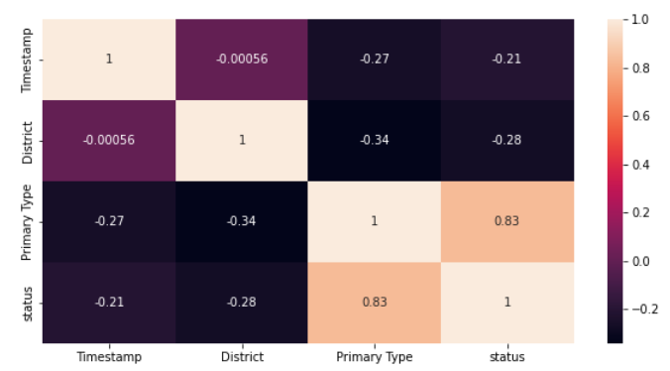
Correlation Matrix table

Slide 8
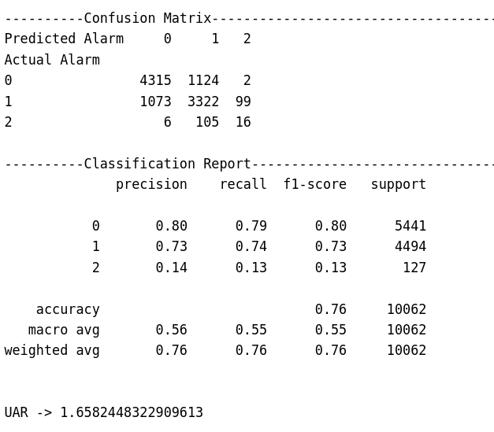
Decision Tree Classifier
Splitting the dataset
Accuracy - 76.05

Slide 9
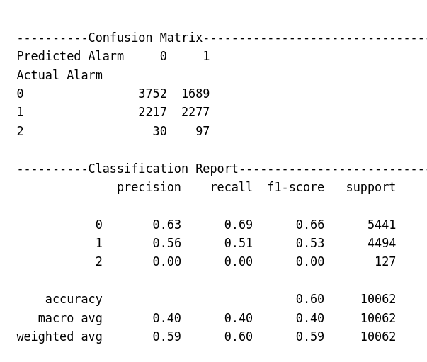
Support-Vector Classifier
Accuracy - 59.91

Slide 10
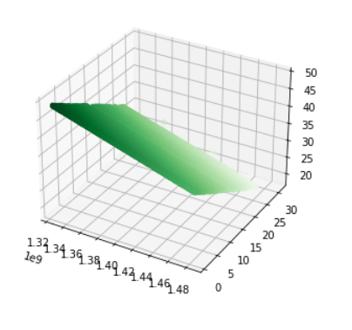
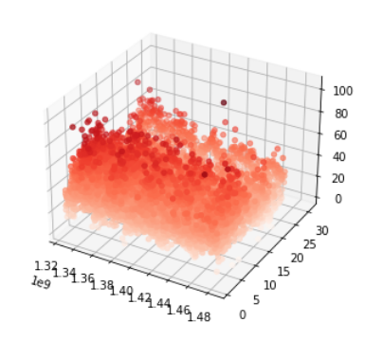
Ridge Regressor
Predicted data
Actual data
Score - 0.1874

